Slide 1
Tech Interview Prep:
Virtualization vs. Containers and Infrastructure as Code
Section 1: Virtual Machines vs. Containers
Section 2: Infrastructure as Code (IaC)
Section 3: Synthesis & When to Use Which
Name: Dara Sen
Class: AD371 (Application architecture)

Slide 2
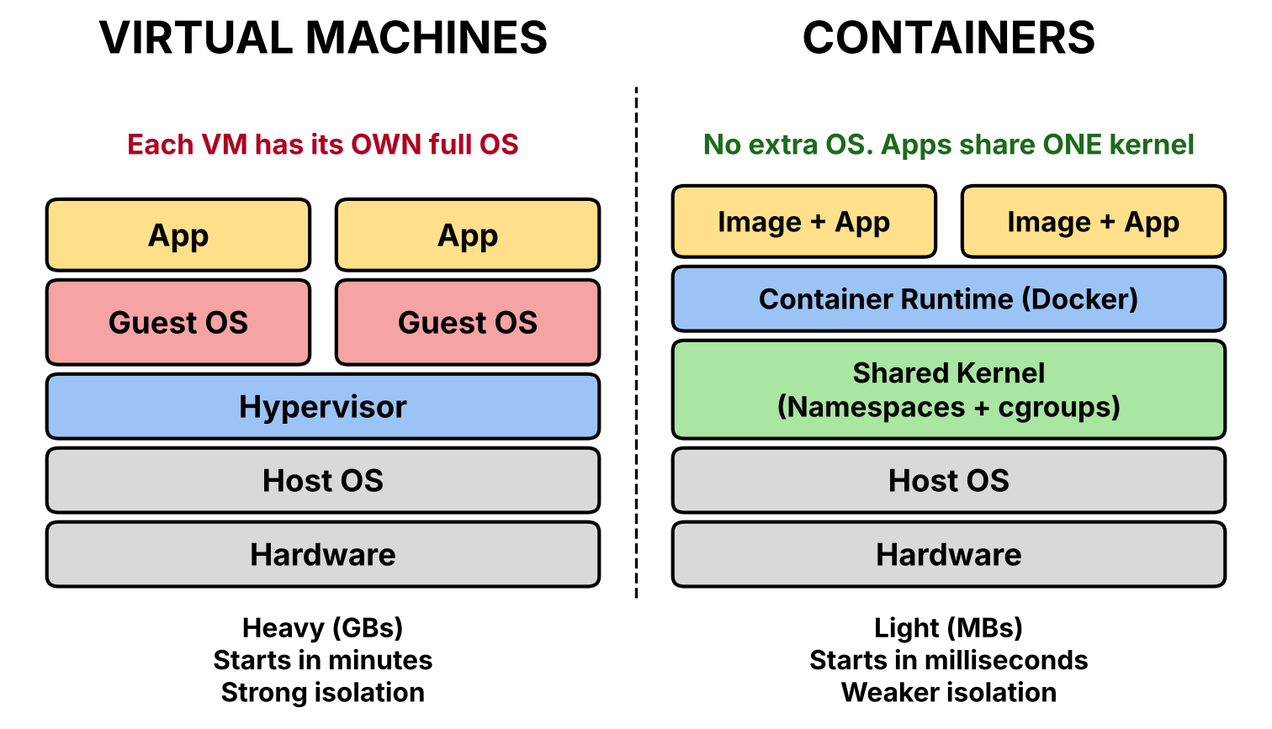
Section 1: Virtual Machines vs. Containers

Slide 3
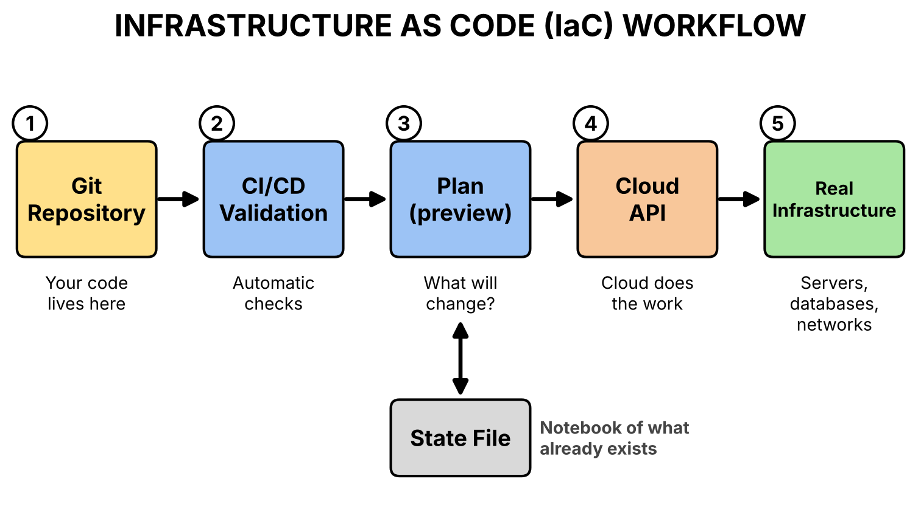
Section 2: Infrastructure as Code (IaC)

Slide 4
Section 3: Synthesis & When to Use Which
Containers vs. Virtual Machines (fast, light, easy to scale vs. strong isolation)
Infrastructure as Code → instead of building servers by hand, write down what we want in a file, and a tool builds it for us.

